Slide 1
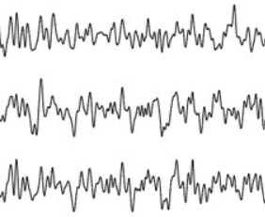
μ
Reconstructed EEG signal (X_{R})
Input EEG signal (X)
EEGNet Encoder
EEGNet Decoder
Reparametrization
Z₁ = μ + σ ⋅ N(0,1)
σ
Classifier
Concatenation
Z₂ = [ μ , σ ]
Label (Y_{c})

